Slide 1
Building on NodeJS’s Policy feature
Policies are a security feature intended to allow guarantees about what code Node.js is able to load [1]
Resources can have Subresource Integrity strings
Integrities are defined in a JSON manifest
If the hash of a file doesn’t match what’s defined in the manifest, then an exception is thrown, and the file isn’t loaded
The integrity of the manifest can be passed as a cmd line arg to node
[1] https://nodejs.org/api/policy.html
Notes:
We were delighted to find that the Node community was already thinking about this and developed a Policy feature, currently in an experimental stage.
And it’s here that we saw an opportunity to close a link in the trust chain.
Currently, trust is anchored in whoever has access to the command line and can execute node.
If a malicious actor is able to execute node on a compromised system, they could modify the launch args to circumvent integrity checks.

Slide 2
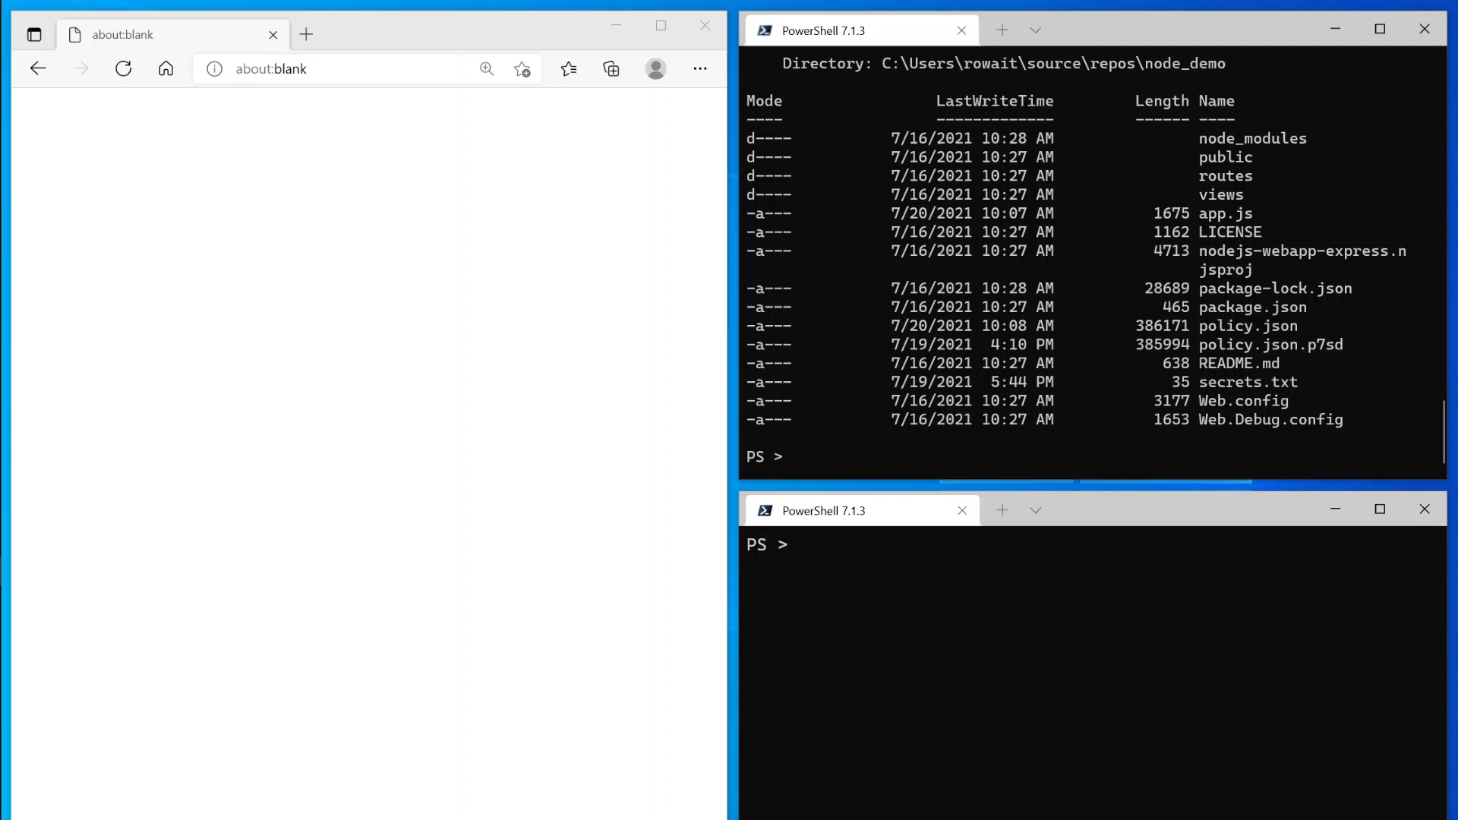

Slide 3
Proposed integration with system code integrity policy
We propose a cooperative model, where the runtime can ask the OS to make decisions on whether something is trusted by system code integrity policy
Replace –policy-integrity with system trust integration
Policy files are accompanied with a PKCS7 detached signature
On startup, Node asks the OS if there’s a code integrity policy
If there is a code integrity policy, Node then asks the OS if the PKCS7 signature of the Policy file is valid and if the signer is trusted
If so, execution continues as normal with the –-experimental-policy flag
Notes:
We want to close the link in the trust chain so that trust is rooted in the system.

Slide 4
